Slide 1
E-Commerce Order, Delivery & Customer Performance Analysis- Capstone Project
Project Created By: Karthik N
Created Date: June 4th, 2026
Project Batch: BMAI-C-WD-E-B33

Slide 2
Project Goal
To apply Business Analytics concepts and tools to analyse transactional data and identify operational inefficiencies, customer behaviour patterns, and performance gaps using PostgreSQL, Excel, Data Warehousing, and Power BI.

Slide 3
Dataset Overview
Dataset Overview
The project uses the Olist Brazilian E-Commerce Dataset, which contains transactional data from a large online marketplace operating across Brazil between September 2016 and October 2018.
Dataset Scope:
99,441 Orders
99,441 Customers
112,650 Order Items
103,886 Payment Records
99,224 Customer Reviews
32,951 Products
3,095 Sellers
738,332 Geolocation Records
Data Domains Covered:
Orders & Delivery
Customers
Products & Categories
Sellers
Payments
Customer Reviews
Geographic Information

Slide 4
Business Problem Statement
Business Problem Statement
E-commerce businesses generate large volumes of transactional data, but extracting actionable insights from this data remains a challenge.
The objective of this project is to design a Data Warehouse and Business Intelligence solution that enables stakeholders to:
Monitor order and delivery performance
Analyze customer satisfaction and retention
Evaluate product category performance and revenue contribution
Understand customer demand across regions
Identify operational inefficiencies and high-risk orders
Support data-driven decision making through interactive dashboards

Slide 5
Data Cleaning & Preparation
Raw Data Ingestion
Imported 8 source datasets into PostgreSQL staging tables (raw_*)
Created separate clean tables (clean_*) for transformation and quality checks
Data Quality Improvements
Removed 268,000 duplicate records from Geolocation dataset
Standardized data types:
Dates → Timestamp
Price & Payment Values → Numeric
IDs → VARCHAR
Corrected inconsistent and blank product category values using translation mapping
Performed null value analysis and handled missing values based on business context
Data Validation
Verified row counts between raw and clean tables
Confirmed primary key uniqueness
Performed completeness and consistency checks before warehouse loading
Raw Tables
↓
Data Cleaning
↓
Data Validation
↓
Clean Tables
↓
Data Warehouse

Slide 6
Data Quality & Audit Results
Record Count Validation
Null Value Assessment
Quality Checks Completed
Table | Records
Customers | 99,441
Orders | 99,441
Order Items | 112,650
Payments | 103,886
Reviews | 99,224
Products | 32,951
Sellers | 3,095
Geolocation | 738,332
Primary Key Uniqueness Verified
Raw vs Clean Table Row Count Validation Completed
Data Type Conversion Validated
Product Category Translation Completed
Duplicate Geolocation Records Removed (268,000+)
Foreign Key Relationships Verified
Column | Null Records
order_approved_at | 160
order_delivered_carrier_date | 1,783
order_delivered_customer_date | 2,965
Audit Conclusion
All datasets successfully passed data quality checks and were approved for loading into the dimensional data warehouse and Power BI reporting layer.

Slide 7
Fact & Dimension Tables
Fact Table(Transactional Data)
Fact Table | Description
fact_orders | Order lifecycle, status, delivery performance, purchase dates
fact_order_items | Products sold, sellers, prices, freight charges
fact_payments | Payment methods, installments, payment values
fact_reviews | Customer review scores and feedback
Dimension Tables (Descriptive Data)
Dimension Table | Description
dim_customer | Customer location and unique customer information
dim_product | Product attributes and category information
dim_seller | Seller details and geographic information
dim_geography | Zip code, city, and state mapping
dim_date | Calendar hierarchy for time-based analysis
Warehouse Statistics
Key Design Principle
Component | Count
Fact Tables | 4
Dimension Tables | 5
Total Tables | 9
Analytical Tasks Supported | 15
The dimensional model separates transactional facts from descriptive dimensions, enabling faster reporting, simplified analytics, and efficient Power BI dashboard development

Slide 8
Star Schema / Data Warehouse Design
Data Warehouse Design (Star Schema)
Objective
Designed a dimensional data model to support business reporting,
KPI tracking, and Power BI analytics.
Fact Tables
Fact Orders
Fact Order Items
Fact Payments
Fact Reviews
Dimension Tables
Dim Customer
Dim Product
Dim Seller
Dim Geography
Dim Date
Benefits
Faster analytical queries
Simplified reporting structure
Scalable dashboard development
Improved business intelligence performance
Model Characteristics
Central transaction facts connected to descriptive dimensions
Supports all 15 business analytical tasks
Optimized for Power BI reporting .
A dimensional star schema was designed to transform transactional e-commerce data into an analytics-ready data warehouse for business reporting and decision-making.
Relationship Diagram (Star Schema)
dim_date
|
|
fact_orders
|
-------------------------
| |
| |
dim_customer fact_reviews
|
|
review_score
fact_orders
|
|
fact_order_items
/ \
/ \
dim_product dim_seller
fact_orders
|
|
fact_payments.
Fact Tables: 4
Dimension Tables: 5
Relationships:
One-to-Many
Architecture:
Star Schema

Slide 9
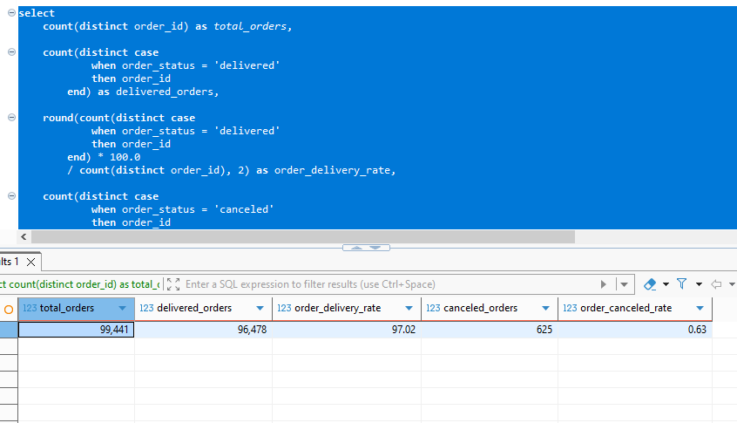
TASK 1 Overall Order Operations Health Check.
Screenshot
Business Question
SQL Logic Used
What is the total number of orders, delivered orders, cancelled orders, and average order value across the dataset?
Calculated total orders, orders delivered,
orders delivery rate, canceled orders,
order canceled rate from fact_orders table.
Key Results
Business Insight
KPI | Value
Total Orders | 99,441
Delivered Orders | 96,478
Delivered % | 97.02%
Cancelled Orders | 625
Cancelled % | 0.63%
Average Order Value | ₹160.99 (
The e-commerce platform processed 99,441 orders during the analysis period. Of these, 96,478 orders were successfully delivered, resulting in a delivery success rate of 97.02%. Only 625 orders were cancelled, representing less than 1% of total orders. The average order value was 160.99, indicating a healthy transaction value across the platform.

Slide 10
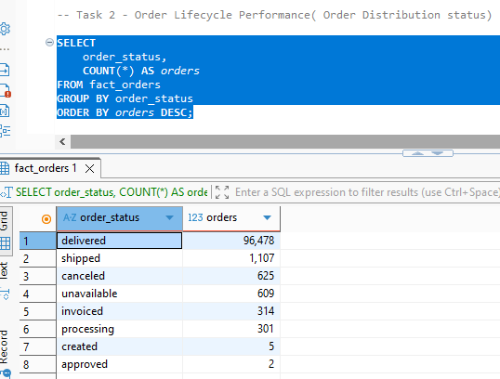
Task 2: Order Lifecycle Performance
Screenshot
Business Question
SQL Logic Used
What is the distribution of orders across different statuses (delivered, cancelled, shipped, etc.)?
Calculated and grouped by order status from fact_orders table
Key Results
Business Insight
Delivered orders dominate the order lifecycle with 96,478 orders, accounting for over 97% of all orders. Only 625 orders were cancelled and 609 were unavailable, indicating a highly efficient fulfillment process. The small number of orders in intermediate states (processing, invoiced, shipped) suggests that most orders successfully progress through the fulfillment pipeline.
Order Status | Orders
Delivered | 96,478
Shipped | 1,107
Canceled | 625
Unavailable | 609
Invoiced | 314
Processing | 301
Created | 5
Approved | 2

Slide 11
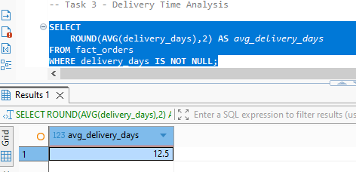
Task 3 - Delivery Time Analysis
Screenshot
Business Question
SQL Logic Used
What is the average delivery time from order purchase to actual delivery?
Calculated average delivery days from fact_orders table.
Key Results
Business Insight
Average Delivery Days is 12.5 days
Customers received their orders in an average of 12.5 days from purchase to delivery. This metric serves as a baseline for evaluating logistics performance and customer expectations.

Slide 12
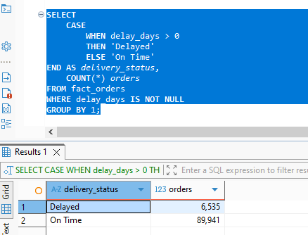
Task 4: Delivery Delay Analysis
Screenshot
Business Question
SQL Logic Used
How many orders are delivered after the estimated delivery date?
Used a case statement and bucketed delayed and on-time orders from fact_orders table
Key Results
Business Insight
Approximately 93.2% of delivered orders reached customers on or before the estimated delivery date. Only 6.8% of orders experienced delays, demonstrating strong logistics and delivery performance.
Delivery Status | Orders
On Time | 89,941
Delayed | 6,535

Slide 13
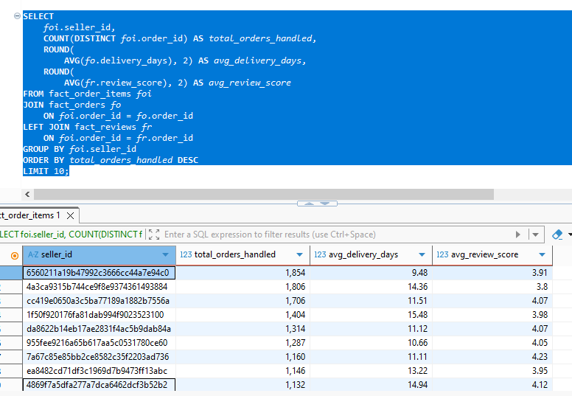
Task 5 Seller Performance Benchmarking
Screenshot
Business Question
SQL Logic Used
For each seller, what are the total orders handled, average delivery time, and average customer review score?
Calculated total orders handled, avg_delivery days, avg_review_score from fact_order_items table
Joined fact_orders and order_items table
Grouped by seller_id
Key Results
Business Insight
Top-performing sellers handle over 1,800 orders while maintaining delivery times below the overall average of 12.5 days. Seller performance varies significantly, suggesting opportunities for benchmarking logistics and customer service practices.
Seller | Orders | Avg Delivery | Avg Review
Top Seller | 1,854 | 9.48 | 3.91

Slide 14
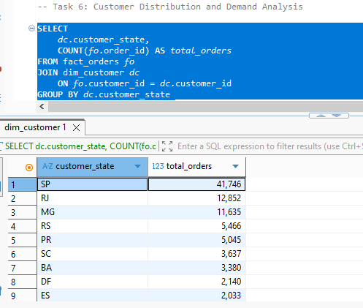
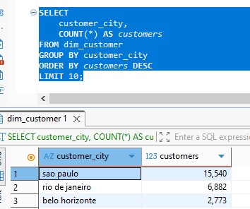
Task 6: Customer Distribution and Demand Analysis
Screenshot
Business Question
SQL Logic Used
Which regions or cities generate the highest number of customers and orders?
Calculated customer_state and total orders.
Joined fact_orders and dim_customer table
Grouped by customer_state
Key Results
Business Insight
State | Orders
SP | 41,746
RJ | 12,852
MG | 11,635
City | Customers
Sao Paulo | 15,540
Rio de Janeiro | 6,882
São Paulo dominates customer demand, contributing more than 40% of all orders. This region should be considered a strategic market for marketing investment and logistics optimization..

Slide 15
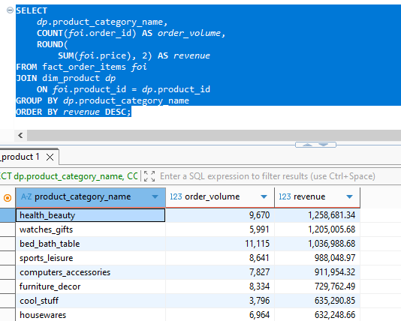
Task 7: Product Category Performance
Screenshot
Business Question
SQL Logic Used
Which product categories generate the highest order volume and revenue?
Calculated product_category_name and order_volume and sum of price.
Joined fact_order_items and dim_product table.
Grouped by product_category_name
Key Results
Business Insight
Category | Revenue
Health Beauty | 1.26M
Watches Gifts | 1.21M
Bed Bath Table | 1.04M
Health Beauty generates both:
High revenue
High order volume

Slide 16
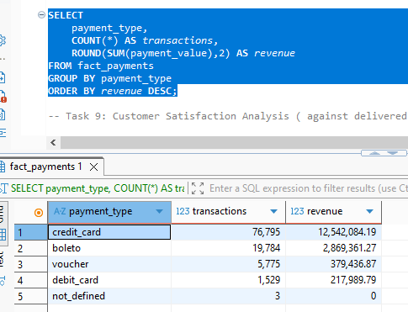
Task 8: Payment Behavior Analysis
Screenshot
Business Question
SQL Logic Used
What is the distribution of payment methods and their contribution to total revenue?
Calculated all transactions and revenue from fact_payments table.
Grouped by payment_type.
Key Results
Business Insight
Credit cards account for the overwhelming majority of transactions and revenue, making them the dominant payment method. Any payment gateway disruptions could significantly impact revenue.
Payment Type | Revenue
Credit Card | 12.5M
Boleto | 2.87M

Slide 17
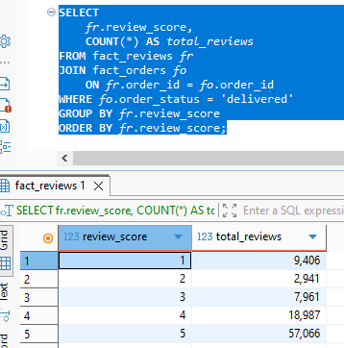
Task 9: Customer Satisfaction Analysis
Screenshot
Business Question
SQL Logic Used
What is the distribution of customer review scores across all orders?
Calculated review_score, total reviews by joining fact_reviews and fact_orders table.
Grouped by review_score
Key Results
Business Insight
More than half of all reviews received the highest possible rating, indicating strong overall customer satisfaction.
Score | Reviews
5 | 57,066
4 | 18,987
1 | 9,406

Slide 18
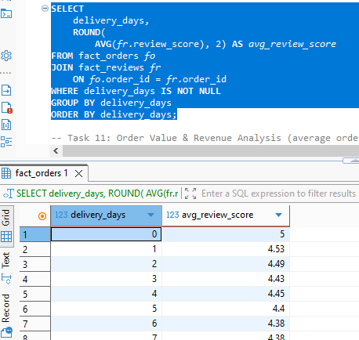
Task 10: Delivery vs Review Relationship
Screenshot
Business Question
SQL Logic Used
How does delivery time impact customer review scores?
Calculated delivery days and avg_review_score by joining fact_orders and fact_reviews table.
Grouped by delivery_days
Key Results
Business Insight
Customer satisfaction decreases as delivery time increases, demonstrating a clear relationship between operational efficiency and customer experience.
Delivery Days | Avg Review
0 | 5.00
1 | 4.53
2 | 4.49

Slide 19
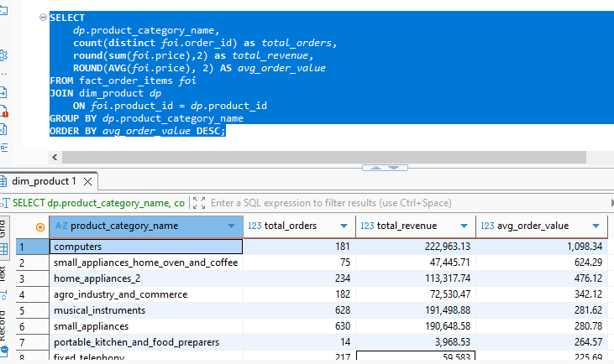
Task 11: Order Value & Revenue Analysis
Screenshot
Business Question
SQL Logic Used
What is the average order value across different product categories?
Calculated product_category_name, total_orders, total_revenue, and avg_order_value by joining fact_order_items and dim_product table.
Grouped by product_category_name
Key Results
Business Insight
Category | Avg Order Value
Computers | 1,098
Small Appliances | 624
Health Beauty drives revenue.
Computers drive value.

Slide 20
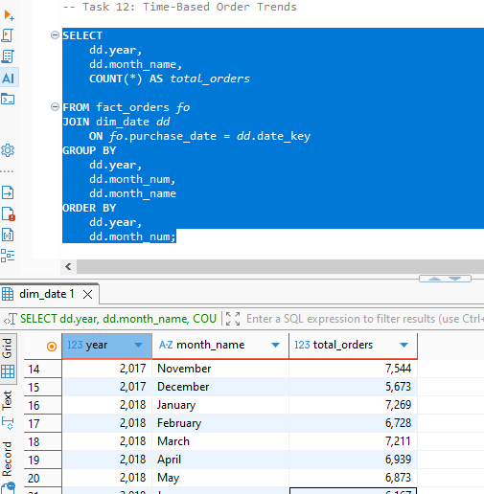
Task 12: Time-Based Order Trends
Screenshot
Business Question
SQL Logic Used
How do order volumes vary over time (monthly or yearly)?
Created dim_date table and joined with fact_orders table. Calculated, year, month, and total orders
Key Results
Business Insight
Between February 2017 to August 2018, there has been highest order volume
Mar 2018 has had the highest orders

Slide 21
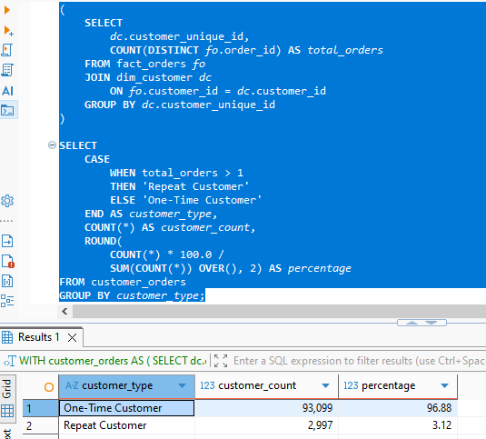
Task 13: Customer Retention Analysis
Screenshot
Business Question
SQL Logic Used
How many customers make repeat purchases?
Created a staging table customer_orders and loaded data by joining fact_orders and dim_customer table. Used a case statement and bucketed customer_type. Calculated percentage of customer_type by dividing count(customer_type, total_orders) and sum(customer_type, total_orders)
Key Results
Type | %
One-Time | 96.88%
Repeat | 3.12%
Business Insight
Only 3.12% of customers made repeat purchases, indicating a significant opportunity to improve customer retention and loyalty programs.

Slide 22
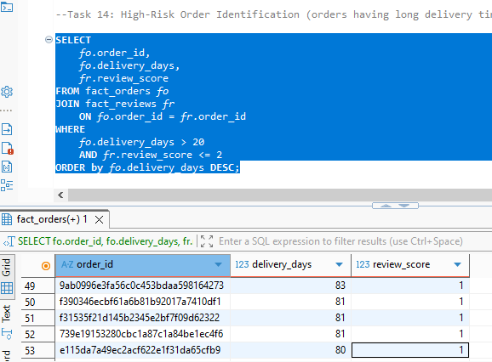
Task 14: High-Risk Order Identification
Screenshot
Business Question
SQL Logic Used
Which orders have long delivery times and low review scores?
Identified those orders which are more than 20 delivery days and review score less 2 by joining fact_orders and fact_reviews table
Key Results
Business Insight
Several orders experienced delivery times exceeding 150–200 days and received poor customer ratings, highlighting critical service failures that require investigation
delivery_days > 20
review_score <= 2

Slide 23
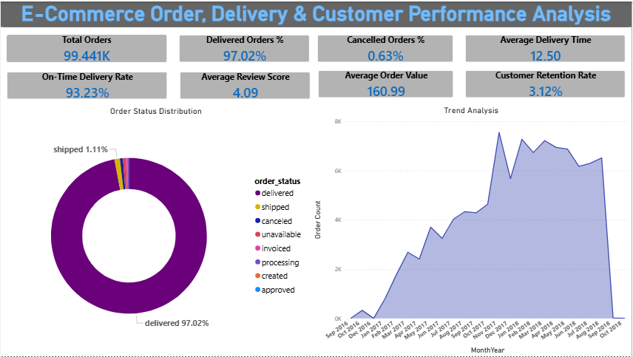
Executive Dashboard

Slide 24
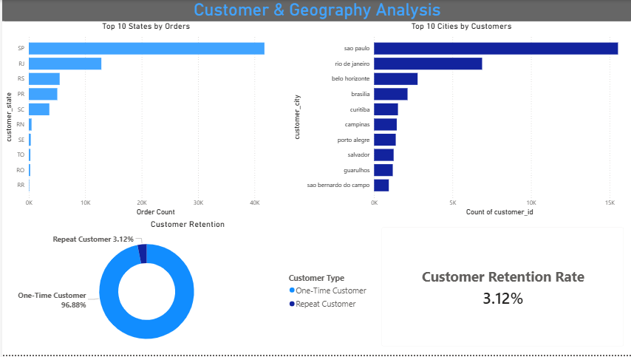
Customer & Geography Dashboard

Slide 25
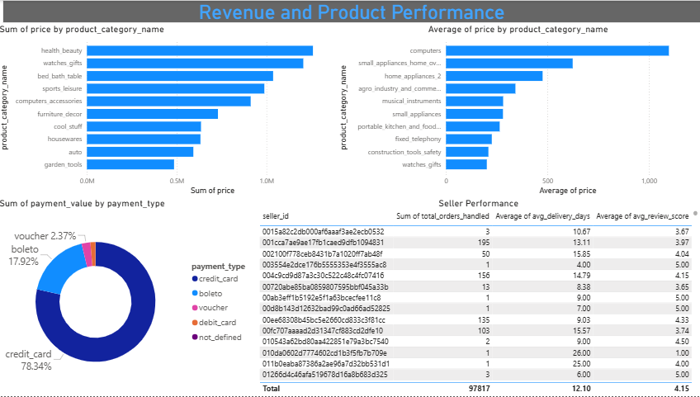
Revenue and Product Performance Dashboard

Slide 26
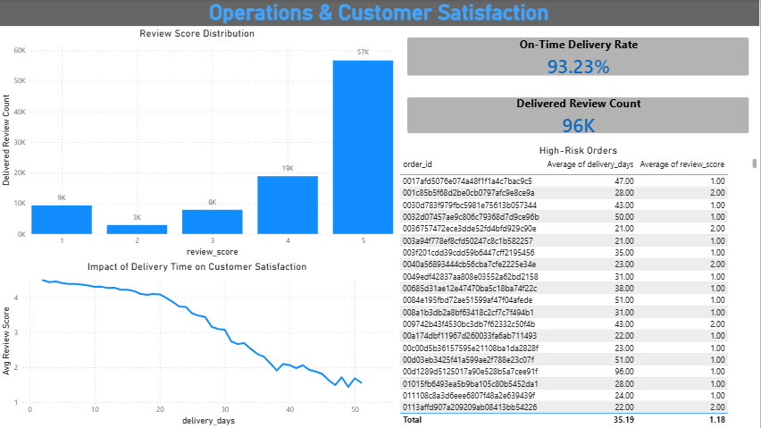
Operations and Customer Satisfaction Dashboard

Slide 27
Task 15 – Executive Performance Summary
Dataset Overview
99,441 Orders | 99,441 Customers | 32,951 Products | 3,095 Sellers
Operational Performance
Delivered Orders: 97.02%
Cancelled Orders: 0.63%
Average Delivery Time: 12.5 Days
On-Time Delivery Rate: 93.23%
Customer Satisfaction
Average Review Score: 4.09 / 5
Majority of reviews were 4-star and 5-star
Customer satisfaction declined as delivery time increased
Revenue & Product Insights
Average Order Value: 160.99
Top Revenue Categories:
Health & Beauty
Watches & Gifts
Bed Bath & Table
Highest AOV Category: Computers
Customer & Market Insights
São Paulo generated 41,746 orders (~42% of total orders)
Customer Retention Rate: 3.12%
96.88% of customers were one-time buyers
Key Business Opportunity
Improve customer retention through loyalty programs
Investigate delayed deliveries and high-risk orders to enhance customer experience

Slide 28
Top Key Findings & Strategic Recommendations
Key Insights
Operations & Delivery
99,441 total orders analyzed
97.02% orders successfully delivered
93.23% delivered on or before estimated date
Average delivery time: 12.5 days
Customer Behavior
São Paulo generated 41,746 orders (~42% of total orders)
Customer retention rate: 3.12%
Revenue & Products
Highest Revenue product: Health & Beauty
Highest AOV Category: Computers
Customer Satisfaction
Average Review Score: 4.09 / 5
Strategic Recommendations
Increase Customer Retention
Improve repeat purchase rate from 3.12% through loyalty programs and personalized campaigns.
Expand High-Performing Categories
Increase inventory and promotions for Health & Beauty, Watches & Gifts, and Bed Bath & Table.
Improve Delivery Performance
Focus on delayed deliveries and high-risk orders to protect customer satisfaction.
Prioritize Key Markets
Allocate marketing and logistics investments toward São Paulo and other high-demand regions.
Strengthen Operational Monitoring
Track delivery delays, review scores, and seller performance using dashboard KPIs.

Slide 29
Final Conclusion
The business demonstrates strong operational performance with 97.02% delivery success, 93.23% on-time delivery, and a 4.09 customer rating. However, customer retention remains a major opportunity, with only 3.12% repeat customers. Future growth can be driven by improving customer loyalty, optimizing delivery performance, and investing in high-performing product categories and regions.

